Slide 1
Chelan-Douglas CHI
February 9, 2022

Slide 2
Agenda
Introductions and Icebreaker
Name, Organization, Icebreaker Question
Icebreaker Question:
Would you rather visit the dentist or visit the doctor?
Updates
Oral health is essential for general health and well-being
Breakout Rooms
Meeting Adjourned

Slide 3
Updates:
Stuff the Bus Event
Call to Action:
Coalition members to help plan the Stuff the Bus Event
Coalition members to volunteer at the Stuff the Bus Event
New Mission Statement
Functions of the coalition
2022 Chelan-Douglas CHI Leadership Council members

Slide 4
New Mission Statement:
The mission of the Chelan-Douglas Coalition for Health Improvement is to provide a space with diverse partners, working together on improving the health and well-being of our community

Slide 5
Functions
1
Collaborative Capacity
2
Support
3
Funding
Ability to work cooperatively with others in a variety of contexts, including collaborative learning, creative thinking, problem-solving, and decision-making
Cross-sector partnerships and networking
Identify opportunities and needs

Slide 6
Functions
4
Assess
5
Advocacy
6
Mobilize
Current gaps and needs
Convene Legislative Forum and other forms of advocacy
To assemble and make ready for action

Slide 7
CD-CHI Leadership Council
Mayra Navarro, Eastmont School District
Mondo Davila, Together for Youth
Nancy Spurgeon, NCACH Governing Board Representative
Rosenda Henley, People for People
Stacy Canada, Confluence Health
Terri Weiss, Upper Valley Mend

Slide 8
Oral health is essential for general health and well-being

Slide 9
Breakout Rooms
To increase knowledge of resources, please provide dental services and oral health education programs.
What can be done at the coalition level to improve access and education about oral health?

Slide 10
Group Discussion
Report Out from Breakout Groups
Group Discussion

Slide 11
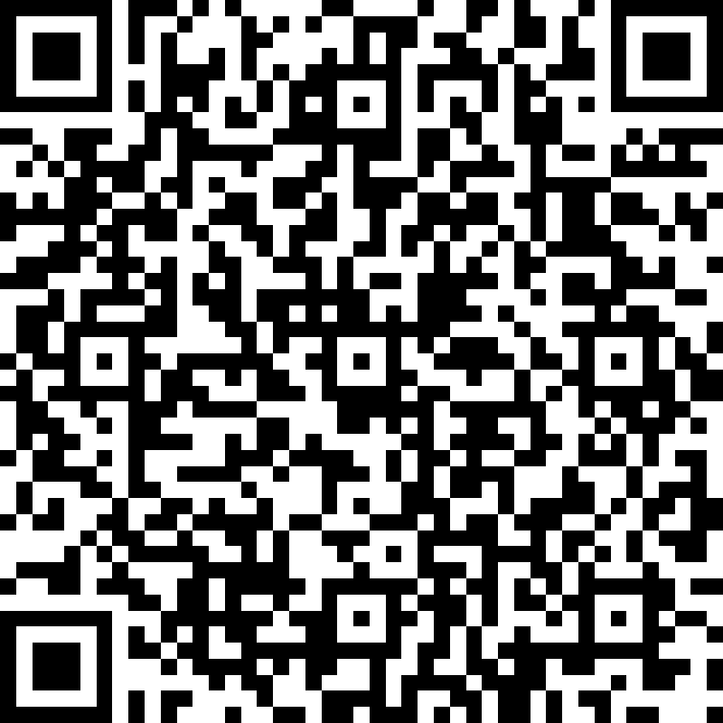
CHI Meeting Evaluation:

Slide 12
Thank you for attending!

