Slide 1
Community Based Strategies to Address the Challenges of Reform
  Jack Thompson: Cedar Rivers Group jrtph@comcast.net
  Vanessa Gaston: Director, Community Services of Clark County
  Vanessa.gaston@clark.wa.gov
  Melanie Gillespie: Executive Director, Community Health Education Foundation
  melanieg@chef.org

Slide 2
Social Determinants Of Health and Community Strategies for Health
JACK THOMPSON
Cedar River Group

Slide 3
Approach and rationale
A guide to thinking about the determinants of population health
Broad social, economic, cultural, health, and environmental conditions and policies at the global, national, state, and local levels
Living and working conditions
  Living and working conditions may include:
  Psychosocial factors
  Employment status and occupational factors
  Socioeconomic status (income, education, occupation)
  The natural and built^{c} environments
  Public health services
  Health care services
a
Social, family and community networks
Individual behavior
Innate
individual traits:
age, sex, race, and
biological
factors
---
The biology of
disease
Over the life span
b
NOTES: Adapted from Dahlgren and Whitehead, 1991. The dotted lines denote interaction effects between and among the various levels of health determinants (Worthman, 1999).
Notes:
a = social conditions include, but are not limited to: economic inequality, urbanization, mobility, cultural values, attitudes and policies related to discrimination and intolerance on the basis of race, gender, and other differences.
b = Other conditions at the national level might include major sociopolitical shifts, such as recession, war, and governmental collapse
c = The built environment includes transportation, water and sanitation, housing, and other dimensions of urban planning
_______________________________________________________
This is a key concept in two important new releases from the Institute of Medicine:
The Future of the Public’s Health in the 21st Century
Who Will Keep the Public Healthy?
This “ecological model” assumes that health and well being are affected by interaction among multiple determinants including biology, behavior, and the environment.
Interaction unfolds over the life course of individuals, families, and communities, and evidence is accumulating that societal-level factors are critical to understanding and improving the health of the public.

Slide 4
Community planning and development
Partnerships on social determinants
Incorporate preventive strategies
Integrate clinical practices
Patient care/population health
Notes:
First circle – integrate physical health, behavioral health and chemical dependency services to create a more coherent system of care – need to go beyond traditional definition of health to interact with housing, criminal justice system, etc
Second - enhance preventive strategies to improve health outcomes and reduce future serious illness (connections with early learning and education, family support)
Third – build the capacity of medical homes to address the social determinants of health for individuals and families through partnerships
Fourth – build the capacity of communities to improve and sustain the health of their residents – includes community planning, development and public policy

Slide 5

State Innovation Models
& State Health Care Innovation Planning
SIM
The State Innovation Models initiative is a national effort and grant program of the Center for Medicare and Medicaid Innovation (CMMI) to identify and spread health practices that result in better health and better care at lower costs.
SHCIP
Washington State was one of three states awarded a nearly $1 million model pre-testing grant to fund collaborative development of a five-year plan for health innovation. Other states have received “model design” grants, and are engaged in similar work. The effort is called:
State Health Care Innovation Planning

Slide 6
The Triple Aim
Improve patient care according to the six aims enunciated by the IOM (care is safe, effective, patient-centered, timely, efficient, and equitable)
Lower the per capital costs of healthcare
3. Improve the health of patient populations and communities
Berwick, Nolan and Whittingham. The Triple aim: Care, Health, and Cost. Health Affairs; May 2008 759-769
Notes:
CMMI recognizes that “better health” is not related only to improvements in the medical care system (1 and 2) but also improvement in the health of the population (3)
This concept is called the “triple aim” and was first articulated by Donald Berwick and his associates at the Institute for Health Improvement; Berwick was later the Director of CMS

Slide 7
To Achieve the Triple Aim, Social Determinants of Health Must be Addressed
Income/employment
Racial, cultural and language barriers
Educational attainment
Housing
Nutrition
Transportation
Neighborhood quality
Access to parks and recreational opportunities
Notes:
FIRST BULLET
Levers include:
systematic training and support provided to housing providers by agencies that have state contracts for enrollment activities
Ongoing enrollment and eligibility assessment integrated with annual eligibility reviews
SECOND BULLET
Use successes like the 1811 housing project, add Medicaid funding for support services
Capital dollars for additional housing for high needs populations could be sought through additional allocations to the State Housing Trust Fund

Slide 8
Our Charge
Ensure that the SIM grant proposal encompasses changes in the health care system and related services that address the social determinants of health and improve the health and well-being of vulnerable families
Notes:
We believe there is a clear nexus between health and access to decent and affordable housing
Housing sector thought leaders we’ve interviewed fully support the concept of integrating behavioral health and chemical dependency services – essential to developing a more effective safety net
But even the best clinical care is ineffective if adequate housing isn’t also addressed
The SIM Plan can’t met the challenge entirely, but can serve as a catalyst for closer collaboration between health programs and the housing sector:
Public and non-profit housing providers can provide a ready-made network for reaching a substantial proportion of the population that is currently enrolled in Medicaid or will be eligible under Medicaid expansion of subsidized care theough the exchange
Here are some opportunities we’ve identified so far

Slide 9
Our Work to Date Suggests the Following
There are opportunities to involve providers from many sectors in outreach and enrollment in health coverage
Such efforts can lead to inter-sectorial communities to improve community health
Such strategies have implications for workforce development
Local strategies are best, but there is a need for statewide consistency in approaches
Notes:
FIRST BULLET
Retool Medicaid plan and payment structures to encourage coherent connections to medical homes with appropriate reimbursement
Integrate mental health with physical health and chemical dependency services as well as changes in the payment structures for supportive services (for example, the decision to authorize Medicaid reimbursement could be vested with the patient-centered medical home)
SECOND BULLET
Adjust Medicaid plan and payment system to take advantage of changes in federal regulations (access to interventions when recommended by licensed practitioner)
Asthma bonds
Disseminate “breathe easy” construction standards to encourage replication of successful models

Slide 10
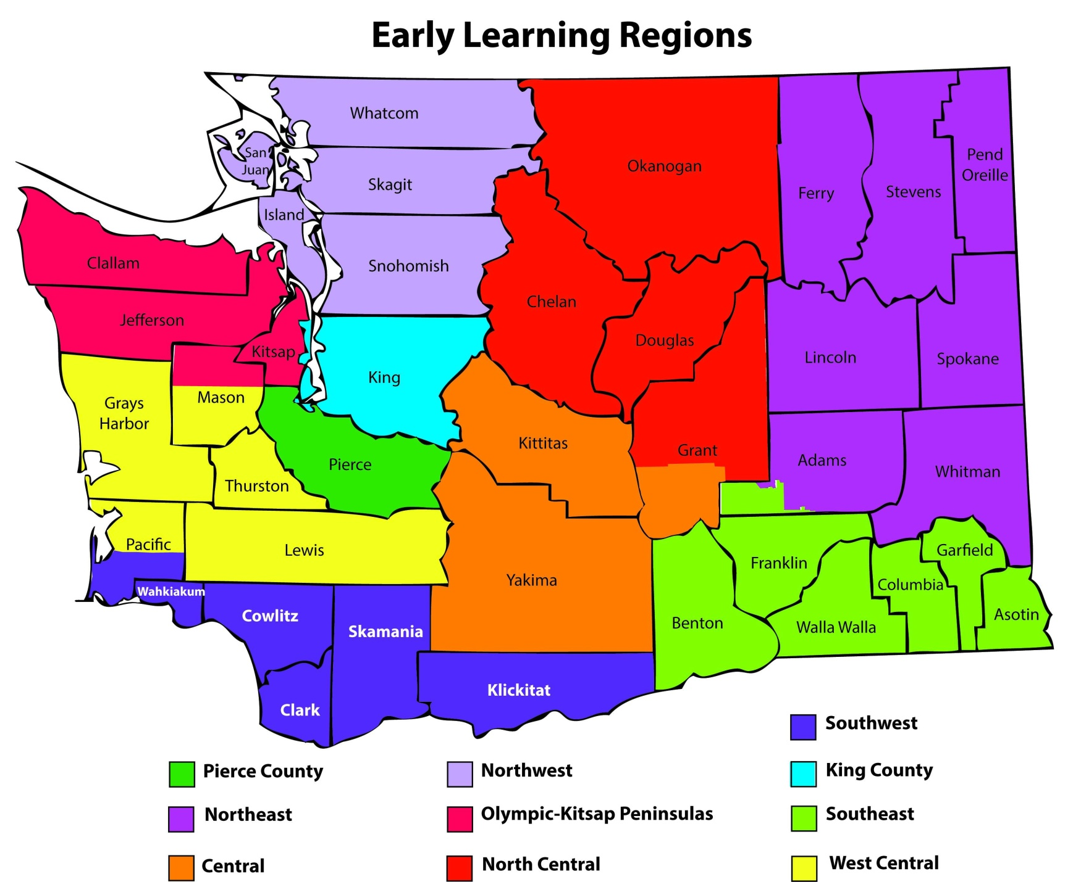

Slide 11

Place Based Health:
Building Healthy Communities
from the Ground UP!
Melanie Gillespie, MBA
Executive Director
melanieg@chef.org l 206.832.1917
© C.H.E.F. 2013
Notes:
39 years old
National activity throughout ‘80s and ‘90’s developing and distributing health education curricula in schools to prevent drug and alcohol abuse, bullying etc
Agency used revenue from these sales to create our endowment
In 2007 the Board focused in more specifically on health inequities
In 2008, staff and board designed a 10 year initiative to work with PHA’s to become model health communities.
I’ll be discussing this initiative today, where it’s at, what we’ve learned and what’s next

Slide 12
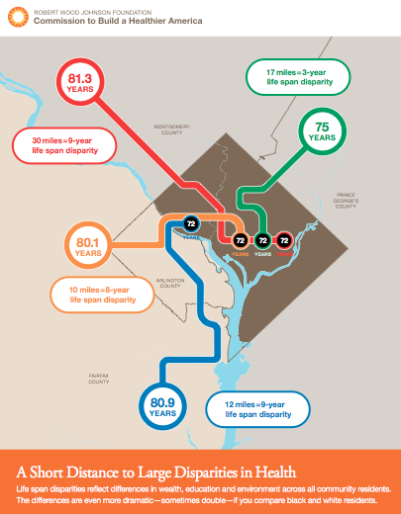

Slide 14
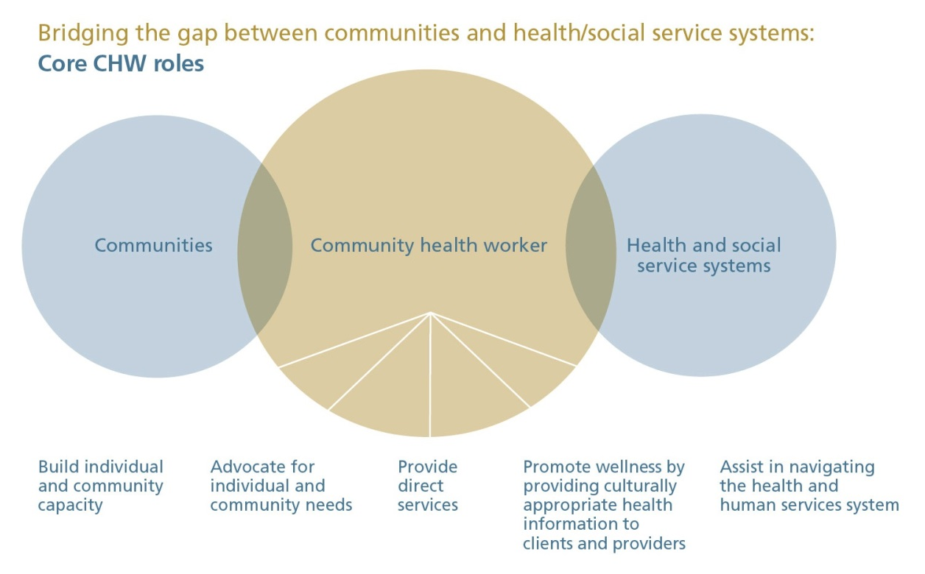
Community Health Workers
Source: Blue Cross and Blue Shield of Minnesota Foundation

Slide 15
Community Health Workers in Low Income Housing Communities
The community health worker model is a well-tested program that works.
We hire a trusted member of the community to act as a “Coach” who facilitates health promotion, disease prevention, and community development initiatives in their community.
Community health workers stimulate grassroots health improvement efforts like community gardens, community kitchens, walking programs, and smoke free policies in public housing.
Community health workers also provide an entré into the community for a wide variety of other programs and initiatives (e.g. school health, immunization, cancer screening, medical home)
Community Health Worker
Community member
Community trust
Community engagement
Grassroots improvements
Pathway to employment
Healthy conditions
Places to be active
Access to healthy foods
Smokefree housing
Work experience
Notes:
Our model with CHW’s in housing
What is a community health worker? This means a lot of things to a lot of people, especially these days with health care reform, but at its root, CHW’s are trusted members of the community who facilitate health promotion, disease prevention and community development.
Our model is based on many years of research as well as growing evidence about the effectiveness of CHW’s.
We look at the informal social network and identify the natural helpers in these networks, in the housing sites in this case.
We activate these folks around health, we give them training and support, ongoing “coaching” to these emerging community coaches” and that accelerates their “helperness.”
CHEF decided to focus its initial energy on 3 counties in WA: Clark, Pierce and Spokane
Each pilot has been different. We are learning as we go with the intent that we will be able to isolate and identify the key variables that must be included for the model to be effective when replicated.
We then will share the model with others and provide coaching to other communities on how to do this, scale it.

Slide 16
CHEF’s Model for Community Health Workers in Affordable Housing
Health
CHA's apply new health/prevention knowledge to own life/family life
Employment
CHA's gain highly marketable knowledge & skills
Training
Advocacy
CHA's become effective advocates for community & build capacity
Community
CHA's build upon existing social networks and develop emerging networks, thus building capacity
Multicultural cohort
Knowledge & skills
Professional network
CULTURALLY APPROPRIATE WAY:
Mentor residents in advocating for themselves
Advocate for residents
Residents become more involved in activities-ownership
Project brings neighbors together
Model network building behavior
Provide support in making changes in habits
Connection to resources
Provide health education
Model healthy behavior
Learn effective advocacy skills

Slide 17
White Paper Recommendation: CHW Task Force for State
Task Force Responsibilities and Questions to Consider:
1. Define CHW scope of practice: What are CHW roles? What activities can they perform? What skills are required?
2. Define training standards: What is the optimal training methodology, development, and delivery? Who should provide training? What is the core content? Should specialized training be provided to address specific diseases or levels of practice? How can training be effective yet also honor the CHW tradition and not create barriers to workforce entry?
3. Identify stable financing models for CHWs: What is the business case for CHWs? What outcome or performance measures should be used to fairly assess their work and value? What are the feasible funding sources?
If we are to achieve Washington State’s goals of improving individual and population health and reducing health care costs, then we must support, develop, and utilize the CHW workforce now.

Slide 18
Southwest Washington Regional Health Alliance (RHA)

Slide 19
Two-Part Idea started Sept 2010:
  A Regional Health Alliance to organize the payors/funders to create a supportive payment and regulatory system
  In order to support organizing the delivery system into accountable systems of care

Slide 20
Key RHA Tasks
Community-wide needs assessment and improvement plan
Multi-Payer “virtual” budget development
Community health improvement projects/hot spotting
Multi-Payer payment, contracting, and performance measure models
Person-Centered Healthcare Home development support
Local ACO development support
Support Patient Registry, EHR, Health Information Exchange development
Community-wide performance measurement

Slide 21
RHA Partners
Project Consultant – Wilson Strategic Communications
FQHCs, Free Clinics & Rural Health Clinics
County Public Health
County Human Services
SW Area Aging and Disability
Hospitals/health systems
Medicaid Health plans
Cowlitz Indian Tribe
Clark College and Lower Columbia College
ESD 112
Consumer representatives and advocates
Behavioral Health providers
Housing and emergency assistance providers
21
Notes:
21

Slide 22
For More Information: http://www.swhealth-alliance.org/
Vanessa Gaston-Vanessa.gaston@clark.wa.gov
DJ Wilson – DJWilson@Wilsonstrategic.com
Erin Thurston-Erin@wilsonstrategic.com

