Slide 1
Okanogan County Coalition for Health Improvement
August 20, 2018

Slide 2
Agenda
Welcome/Introductions
NCACH Updates
Fully Integrated Managed Care: Meet the Managed Care Organizations
SkillSource presents – the North Central Washington Partnership Directory and Okanogan Workforce Collaboration Summit
Membership, Governance, and Decision-Making: What it means to be a CHI member
Roundtable

Slide 3
NCACH Updates
Pathways HUB will be launching in October 2018 in Moses Lake, serving Medicaid or Medicaid-eligible populations who have had 3+ ED visits in a 12-month period
Transitional Care and Diversion Interventions have developed a funding model and application for hospital partners to adopt a transitional care model across the region
Whole Person Care Collaborative providers have recently submitted change plans, highlighting change tactics to improve quality and access to care, as well as to maximize provider resources
Opioid Rapid-Cycle awards issued – projects underway. More funding and opportunities to get involved to be released soon.
CHI Stakeholder Survey results are back – final summary to be released by October 2018 meeting

Slide 4
FIMC: Meet the MCOs serving Okanogan County beginning January 2019

Slide 5
SkillSource: NCW Partner Resource Directory & Okanogan Workforce Collaboration Summit

Slide 6
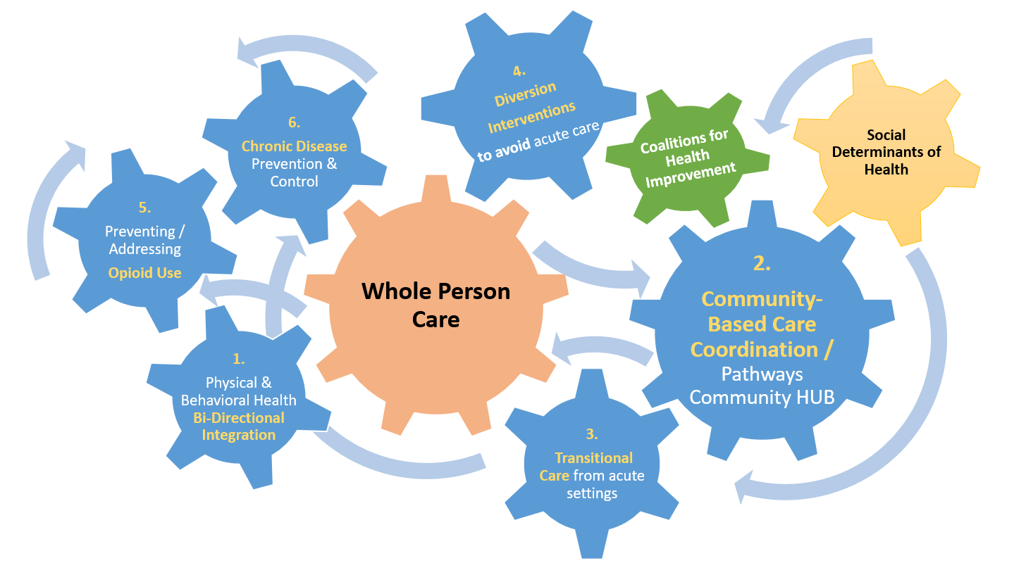
Okanogan County CHI Membership, Governance, and Decision-Making
Each Coalition for Health Improvement has a Governing Board seat, Leadership Council, and a membership charter
Only members who have signed charters are able to vote or introduce motions to the group
Charter commitments:
“Coalition Members agree to regularly attend scheduled meetings and actively participate in the work of the Coalition. Minimum requirement is defined as attending at least 50% of rolling calendar year meetings.
Coalition Members will sign a Membership Agreement”

Slide 7
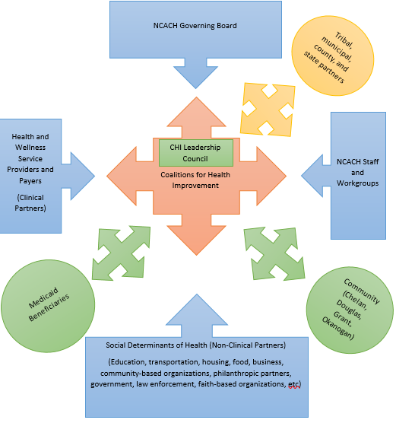
Okanogan County CHI Membership, Governance, and Decision-Making
CHI Leadership Council:
Determines agendas for each CHI meeting; Facilitates activities
Sits on monthly CHI Leadership Council calls to align regional priorities with all three Coalitions. Provides direct feedback to NCACH.
Supports Governing Board seat, facilitates board nominations
Keeps county-level priorities in mind and represented at regional level
Open to all chartered members

Slide 8
Okanogan County CHI Membership, Governance, and Decision-Making
Charge of the CHIs: From the Charter, version July 2017
The mission of the Okanogan Coalition for Health Improvement (“Coalition”) is to foster authentic community engagement and create an ongoing pathway for gathering input from diverse groups of community members for the work of the North Central Accountable Community of Health (NCACH). Coalition members will advise the Governing Board on issues directly related to NCACH’s mission and activities, including needs assessments and local health data; community health improvement plans and priorities; health improvement initiatives; project planning and selection; and delivery system transformation. Input from each Coalition, from the voting member on the NCACH Governing Board and through other means, will be utilized in the decision making process of the Governing Board, and any decision and direction approved by the Governing Board will be shared with the Coalition from the Coalition Governing Board Member.

Slide 9
Okanogan County CHI Membership, Governance, and Decision-Making
Charge of the CHIs: From the Roles, Vision, and Possibilites document, developed by the CHI Leadership Council and adopted by NCACH Governing Board in April 2018
Vision: To foster connectedness, resiliency, and collective impact to support whole person care among our community members through cross-sector, solution-oriented approaches.
Purpose: Coalitions for Health Improvement (CHI) are the critical access point for the voice of our community to be reflected in NCACH’s Medicaid Transformation work. They are open to anyone interested in improving whole person care at a local level through education, outreach, and coordinated efforts. Partners whose sectors represent the social determinants of health, behavioral and physical health, criminal justice system, education, and others are encouraged to participate. As CHIs engage with local project implementation efforts, they ensure that county-level priorities and needs are not lost in regionalization and are uniquely positioned to help address social determinants of health based on their expertise and knowledge of local resources.

Slide 10
Okanogan County CHI Membership, Governance, and Decision-Making
For the next meeting:
What is the mission of the Okanogan County Coalition for Health Improvement?
What are our goals for 2018? 2019?
What do you want from the CHI?

Slide 11
Round Table

