Slide 1
Okanogan County Economic Update
For: Okanogan Coalition for Health Improvement, Okanogan County Public Health
By: Donald W. Meseck, Regional Labor Economist, Labor Market and Economic Analysis (LMEA), ESD
February 25, 2021
Notes:
My name is Don Meseck, Regional Labor Economist, assigned to the Labor Market and Economic Analysis Branch (LMEA), Washington State Employment Security Department.
I provide economic analysis services and Labor Market Information (LMI) for a seven-county area in Washington State. Some of our major clients are: WorkSource offices, the North- and South-Central Washington Workforce Development Councils, economic development councils, Job Corps centers, chambers of commerce, ports, public and private sector schools, rotary and Kiwanis clubs, elected officials, the media, banks, realtors, other businesses, etc. primarily in Adams, Chelan, Douglas, Grant, Kittitas, Okanogan, and Yakima counties.

Slide 2
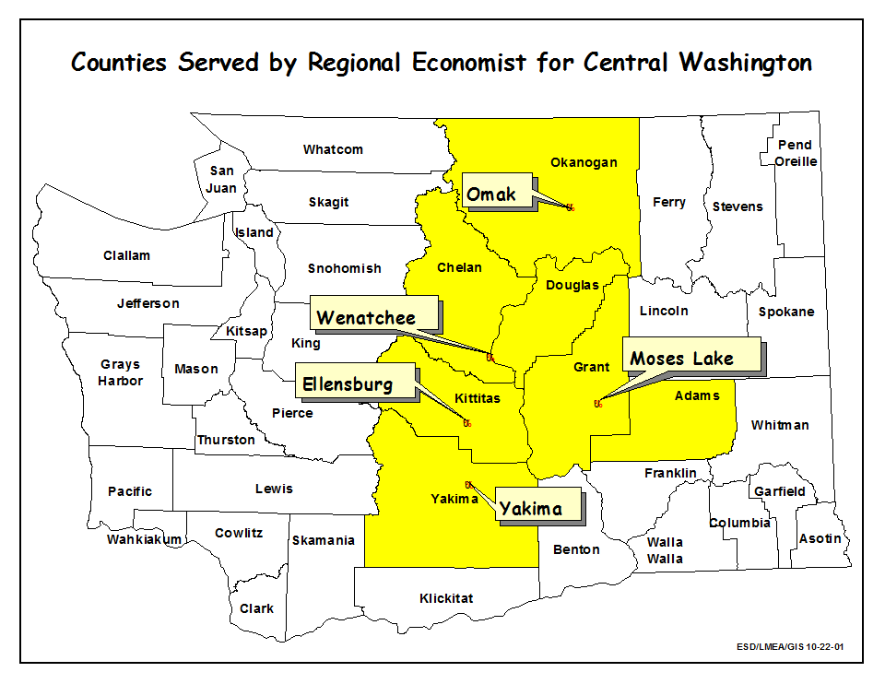
My Area of Responsibility: Adams, Chelan, Douglas, Grant, Kittitas, Okanogan, and Yakima counties
Notes:
This is a map illustrating the seven Central Washington counties for which I provide Labor Market Information (LMI). They are:
Adams County
Chelan and Douglas counties (the Wenatchee Metropolitan Statistical Area or MSA)
Grant County
Kittitas County
Okanogan County
Yakima County (the Yakima MSA)

Slide 3
Today’s presentation
Long-term employment and wage trends (2009-2019) using Quarterly Census of Employment and Wage (QCEW) or “covered” data - for Okanogan County
Slides 4-10
Labor market analysis (through December 2020) for Washington State and for Okanogan County:
Civilian Labor Force (CLF) and unemployment Slides 11-13
“Nonfarm” industry employment trends
Slides 14-18
Summary and Point of Contact (POC)
Slides 19-22
Notes:
In Slides 4-10 will discuss employment and wage trends, as of 2019, for the 22 major sectors (at the 2-Digit NAICS level) in Okanogan County. Please note that 2019 is the most recent year for which we have detailed (i.e., 3-Digit NAICS) annual average employment and wage data at the county level. Revised average annual total covered employment and wage data for 2019 became available as of September 2020, and preliminary average annual employment and wage data for 2020 should become available in June 2021.
In Slides 11-18 will summarize average annual unemployment rate and nonfarm employment trends from 2008-2020 in Washington State and in Okanogan County. Civilian Labor Force (CLF) data from the BLS’ Local Area and Unemployment (LAUS) program and nonfarm employment estimates from the Current Employment Statistics (CES) program, through December 2020, were used to provide much of this analysis. These data are not as detailed as QCEW data, but they are more recent (i.e., up through December 2020) a provide a current view of local and statewide economies.
In Slides 19-22 will provide a summary/overview of what I consider are noteworthy long-term and short-term economic trends in Okanogan County. Will also provide some hyperlinks to our Labor Market Information (LMI) website and my Point of Contact (POC) information.

Slide 4
Analyzed county-level QCEW data for 22 industries/sectors
19 private-industry sectors |  | Three government sectors
NAICS 11 (Agriculture, forestry and fishing) |  | Federal government
NAICS 21 (Mining) |  | State government
NAICS 22 (Utilities) |  | Local government
NAICS 23 (Construction)
NAICS 31-33 (Manufacturing) |  | * North American Industry Classification System (NAICS)
NAICS 42 (Wholesale trade)
NAICS 44-45 (Retail trade)
NAICS 48-49 (Transportation and warehousing)
NAICS 51 (Information)
NAICS 52 (Finance and insurance)
NAICS 53 (Real estate and rentals)
NAICS 54 (Professional and business services)
NAICS 55 (Management of companies)
NAICS 56 (Administrative and waste services)
NAICS 61 (Private education services)
NAICS 62 (Health services)
NAICS 71 (Arts, entertainment and recreation)
NAICS 72 (Accommodation and food services) |  | QCEW is the Quarterly Census of Employment and Wages, a
NAICS 81 (Other services) |  | U.S. Bureau of Labor Statistics data set.
Notes:
The North American Industry Classification System (NAICS) is an industry classification system that groups businesses/organizations into categories or sectors based on the activities in which they are primarily engaged. An important take-away here: there are 19 private-sector and 3-government sectors (i.e., categories) into which employment and wage figures for all business and government organizations (covered under the unemployment compensation system) are grouped at county and state levels.
For Slides 4-10 of this briefing, changes in covered employment in Okanogan County in these 22 NAICS sectors from 2009-2019 were analyzed using Washington State Employment Security Department’s Quarterly Census of Employment and Wage (QCEW) data.

Slide 5
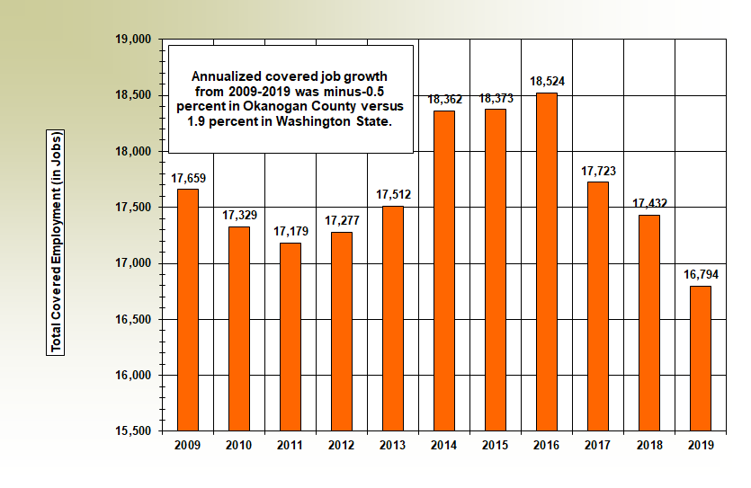
Okanogan County: Total covered employment fell 4.9 percent (down 1,260 jobs) from 2009-2019
Source: QCEW Data
Notes:
The National Bureau of Economic Research (NBER) announced that a national recession occurred from December 2007-June 2009. The employment “apex” of pre-recession Okanogan County occurred in 2008 when covered employment rose to 17,698 (not on this slide). It then took six years (from 2009-2014, inclusive) for the local labor market to meet or exceed this pre-recession high. By 2014, Okanogan County’s economy averaged 18,362 jobs. However, this local economic recovery was relatively “short-lived.” In 2017, just three years later, the covered employment again began slipping down a “slippery slope” – as this slide demonstrates.
In the most recent 10-year period (2009-2019), total covered employment in Okanogan County fell from 17,659 jobs in 2009 to 16,794 in 2019, an 865-job and a 4.9-percent downturn.
Annualized covered employment job growth rates from 2009-2019 were minus-0.5 percent in Okanogan County versus 1.9 percent in Washington State.

Slide 6
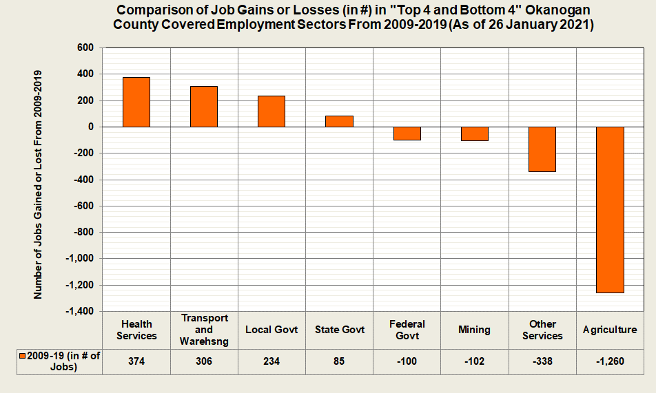
Long-term (2009-2019) employment trends: Job losses in the agricultural sector have been severe
Source: QCEW Data
Notes:
This slide ranks the “Top 4 and Bottom 4” sectors in terms of covered employment changes during the most recent ten-year period (2009-2019) for all 22 sectors (at the 2-digit NAICS level) in Okanogan County.
During the past ten years (2009-2019) in Okanogan County:
The “Top 4:” – Health services, transportation and warehousing, local government, and state government ranked 1, 2, 3, and 4 (respectively) in terms of the number of jobs gained. However, most of the jobs “gained” in private health services, and most jobs lost in “other services” were due to an administrative NAICS reclassification in 2014. In this year: private household employment and wages (NAICS 814) were reclassified into services for the elderly and disabled (NAICS 624) in the first quarter of 2014 by the Bureau of Labor Statistics (BLS).
The “Bottom 4:” – Federal government, mining, other services, and agriculture ranked 19, 20, 21, and 22 (respectively). In terms of employment changes by sector, these sectors lost the most jobs during this ten-year period. Clearly, job losses in Okanogan County’s agricultural sector from 2009-2019 have been severe.

Slide 7
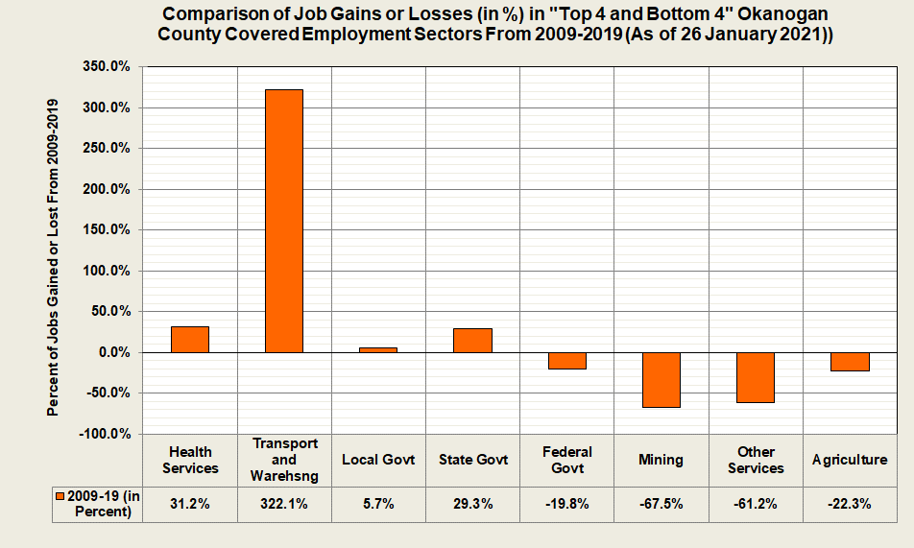
Long-term (2009-2019) job growth rates: Exceptional in transportation and warehousing, good in health services and state government
Source: QCEW Data
Notes:
This slide ranks the “Top 4 and Bottom 4” sectors (from the previous slide) in terms of percentage changes in covered employment during the most recent ten-year period (2009-2019) for all 22 sectors (at the 2-digit NAICS level) in Okanogan County.
During the past ten years (2009-2019) in Okanogan County:
The “Top 4:” – Health services, transportation and warehousing, local government, and state government had positive job growth rates. The transportation and warehousing sector stands out, with a 322.1-percent growth rate. Although detailed 3-digit NAICS QCEW data from 2009-2019 in Okanogan County is only available (due to confidentiality restrictions) for NAICS 484 (truck transportation); it can be stated that growth occurred in the following subsectors in Okanogan County: truck transportation, transit and ground passenger transportation, support activities for transportation, courier and messengers, and warehousing and storage.
The “Bottom 4:” – Conversely, job loss-rates in federal government, mining, other services, and agriculture, during this most recent ten-year period, are provided here.

Slide 8
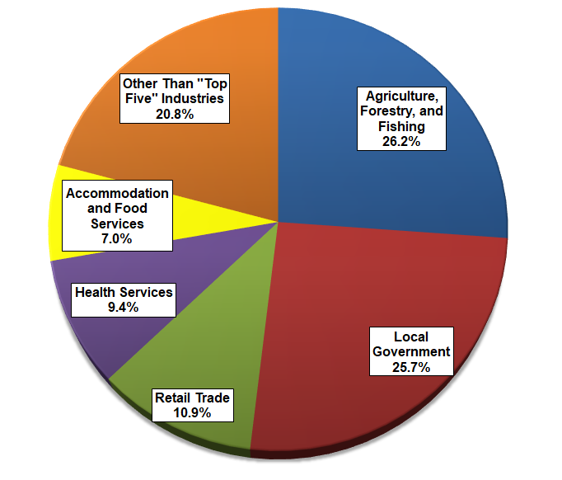
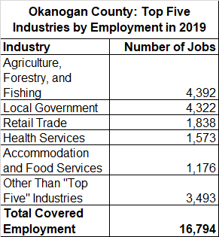
Okanogan County: Top 5 industries by covered employment in 2019
Source: QCEW Data
Notes:
This slide and the next slide (“Top 5 industries by wages in 2019”) rank Okanogan County’s top industries in terms of jobs and wages provided in the 22 major industries/sectors, mentioned earlier.
In 2019, QCEW data showed that Okanogan County’s labor market provided 16,794 jobs. Nearly four of every five (79.2 percent) of all local covered jobs were in five two-digit NAICS industries or sectors (agriculture, local government, retail trade, health services, and accommodation and food services).
Over one quarter (26.2 percent) of all Okanogan County jobs were in the agriculture, forestry, and fishing category (in which most of these jobs are in agriculture).
Local government was the second-largest employment sector in Okanogan County in 2019, accounting for 25.7 percent of total covered employment and averaging 4,322 jobs. This sector tallies jobs at public schools, public utility districts, police and fire departments, courts, libraries, public health districts, Native American organizations/businesses, etc.

Slide 9
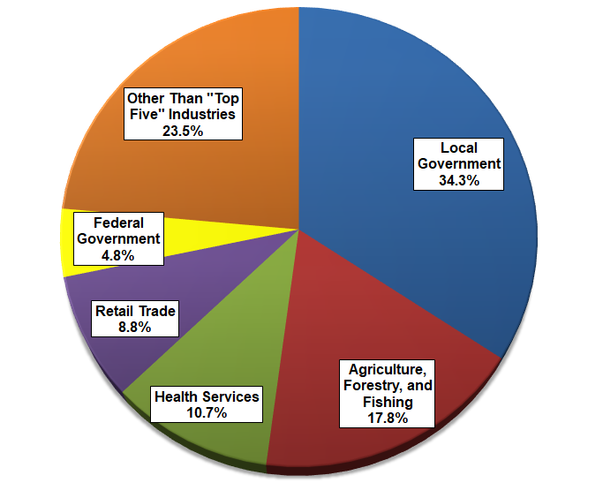
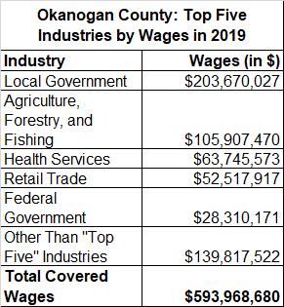
Okanogan County: Top 5 industries by covered wages in 2019
Source: QCEW Data
Notes:
In 2019, QCEW data showed that Okanogan County’s labor market provided over $593.9 million in wages.
Over half (52.1 percent) of total earned wage income countywide in 2019 was earned in just two industries: local government and agriculture.

Slide 10
Okanogan County in 2019: Summary of “Top 5” industries (by covered employment)
Total covered wages = $594.0 million
Average annual employment = 16,794
Average annual wage = $35,368 (50.8 percent of Washington State’s average annual wage in 2019 of $69,606)
Industry | Percent of jobs (in Okanogan County) | Percent of wages (in Okanogan County)
Agriculture | 26.2 | 17.8
Local government | 25.7 | 34.3
Retail trade | 10.9 | 8.8
Health services | 9.4 | 10.7
Accommodation and food services | 7.0 | 3.8
Notes:
This slide compares the “Top 5” industries (i.e., the sectors that provided the most jobs in Okanogan County in 2019) with the wages/payrolls these sectors pumped into the local economy.
In 2019 the average annual wage in Okanogan County was $35,368, which was 50.8 percent of the average annual wage in Washington state of $69,606. Please note that Washington State’s average annual wage is relatively high primarily, although not entirely, due to higher wages/payrolls (especially in King and Snohomish counties) from the aircraft manufacturing and software publishing industries.
Although the agricultural industry provided well over one-fourth (or 26.2 percent) of all covered jobs countywide in 2019, it tallied only 17.8 percent of total covered payroll. Why? Many jobs in agriculture are seasonal.
In calendar year 2019, local government (i.e., public schools, public utility districts, police and fire departments, courts, libraries, public health districts, Native American organizations/businesses, etc.) ranked 1st of the 22 NAICS sectors in terms of payroll dollars injected into the Okanogan County economy. Over one of every three dollars (34.3 percent) of wage income earned locally in 2019 was earned by a person working at a local government organization.

Slide 11
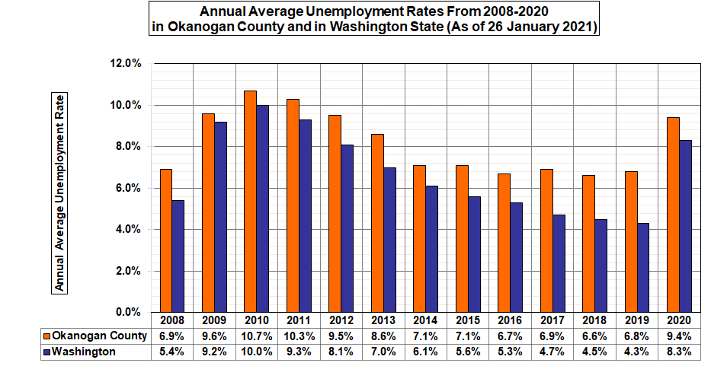
From 2019-2020 the Okanogan County unemployment rate rose two and six-tenths points
Notes:
Please note that during this most recent twelve-year period (2008-2020) not seasonally adjusted rates peaked in Okanogan County and in Washington State in 2010. Since then:
Unemployment rates in Washington declined for nine consecutive years statewide (2011-2019, inclusive). The 4.3-percent average annual unemployment rate for Washington State was the lowest unemployment rate for the Evergreen State in recent recorded history (since the Employment Security Department began compiling unemployment data electronically in 1990). However, between 2019 (4.3 percent) and 2020 (8.3 percent) the rate soared by four full percentage points. This preliminary average annual 2020 rate for Washington State will likely be revised when statewide labor force data for January 2021 are released on 3 March 2021.
Unemployment rates in Okanogan County stabilized or declined every year between 2011 and 2016 (inclusive). The local unemployment rate then elevated modestly in 2017 (primarily due to the layoffs caused by the closure of Omak Forest Products plant in Omak in February 2017). Unemployment then dipped in 2018 but rose two-tenths of a point (to 6.8 percent) in 2019. The rate then jumped to 9.4 percent (up two and six-tenths points) in 2020. This preliminary 2020 rate for Okanogan County will likely be revised when county-level labor force data for January 2021 are released on 9 March 2021.

Slide 12
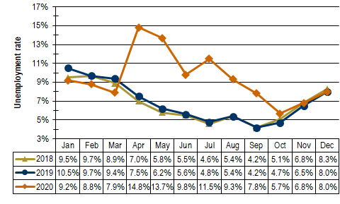
Unemployment Rates in Okanogan County: From January 2018-December 2020 (As of 26 Jan 21)
Source: LAUS Data
Notes:
Year over year, COVID-19 related layoffs pushed local rates upwards from April through November 2020 (as shown in this slide). However, the unemployment rate in Okanogan County stabilized at 8.0 percent between the Decembers of 2019 and 2020, a small step in the right direction for the local economy.

Slide 13
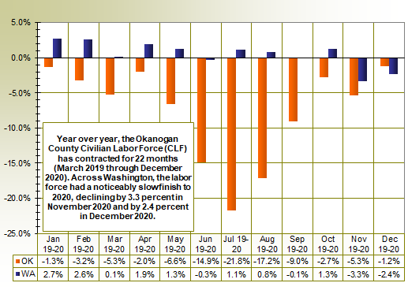
Okanogan County’s labor force has contracted in each of the past 22 months
Source: LAUS Data
Notes:
Okanogan County's CLF drove downward by 7.9 percent in 2020. Year over year, the County’s labor force has been shrinking for 22 consecutive months (March 2019 through December 2020).
Washington's Civilian Labor Force (CLF) expanded by 18,131 residents (a modest 0.5-percent upturn) from 2019 to 2020, with most of this upturn occurring in the first half of 2020. The State’s labor force had a noticeably slow finish to 2020, retrenching year-over-year by a minus-3.3 percent in November 2020 and by minus-2.4 percent in December 2020.

Slide 14
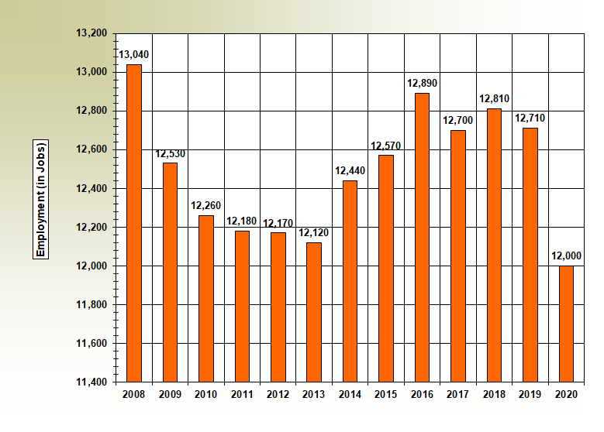
Okanogan County: Total nonfarm employment from 2008-2020
Source: QCEW Data
Notes:
The National Bureau of Economic Research (NBER) announced that the national recession occurred from December 2007-June 2009. But the effects of this recession hit Okanogan County’s nonfarm market for five years (from 2009-2013, inclusive). You can see that the “valley” of this local recession occurred in 2013. Please keep in mind that these total covered employment and wage data, include nonagricultural and agricultural employers.
The pre-recession peak for total nonagricultural employment in Okanogan County was 13,040 jobs in 2008, but it fell for the next five consecutive years until it hit the ‘trough” of 12,120 jobs in calendar year 2013.
One of the differences that emerges when comparing total “nonfarm” employment versus total “covered” employment in Okanogan County since 2008 is that the local nonfarm economy has not yet “recovered” since the Great Recession (from Dec 07-Jun 09):
The high point in Okanogan County’s “nonfarm” employment was 13,040 in 2008. Although the economy moved upwards to 12,890 nonfarm jobs in 2016, it has generally diminished since then.
Conversely, total “covered” employment (see Slide 5) had reached a pre-recession high 17,698 jobs in 2008; and from 2014-2016 “covered” employment rebounded – reaching levels above 18,000 jobs.

Slide 15
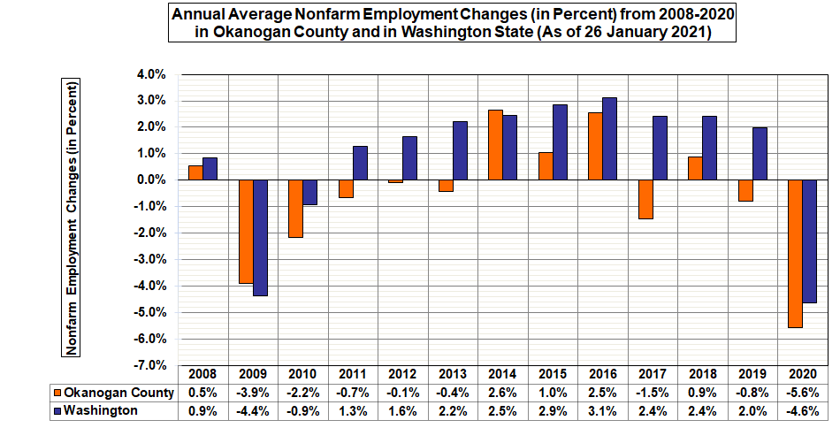
In Okanogan County: the minus-5.6 percent job loss-rate in 2020 was one and seven-tenths points “worse” than the minus-3.9 percent loss-rate in 2009
Notes:
On an average annual basis, Okanogan County's nonfarm labor market has contracted in three of the past four years (2017 through 2020, inclusive).
Estimates show that the COVID-related job loss-rate in 2020 was particularly dismal, with the minus-5.6 percent loss-rate indicating a labor market slackening more severe than the minus-3.9 percent job loss-rate in 2009 - during the heyday of recent recession.
Last year’s minus-5.6 percent loss-rate in Okanogan County was larger than Washington’s minus-4.6 percent nonfarm job loss-rate during 2020.

Slide 16
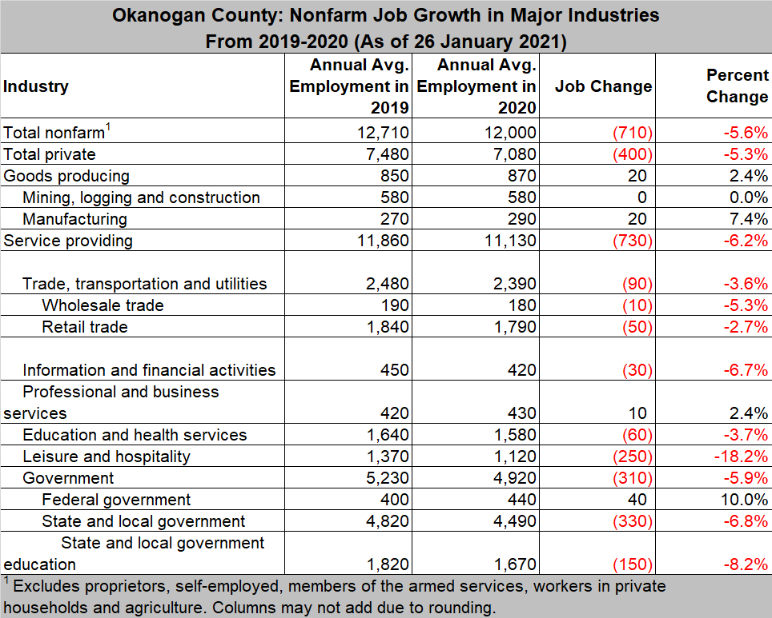
Okanogan County: Nonfarm job growth from 2019-2020 (As of 26 Jan 21)
Notes:
The Okanogan County nonfarm market averaged 12,000 jobs in 2020 versus 12,710 in 2019, a 710-job and 5.6-percent downturn.
Job losses in the following two categories accounted for over eighty percent of all nonfarm jobs lost in 2020:
Leisure and hospitality (primarily hotels, eating and drinking places, and amusement and recreation services) lost 250 jobs last year (down 18.2 percent) accounting for over a third (35.2 percent) of all nonfarm jobs lost countywide in 2020.
State and local government employment decreased by 6.8 percent, netting 330 fewer jobs in 2020 than in 2019.

Slide 17
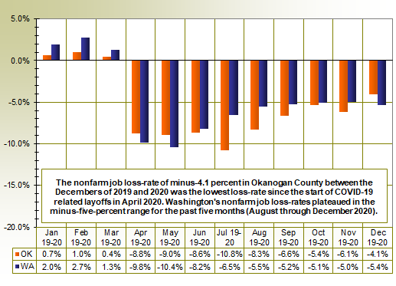
Nonfarm job loss-rates in Okanogan County decelerated during the 3rd and 4th Quarters of 2020
Notes:
(See text box)

Slide 18
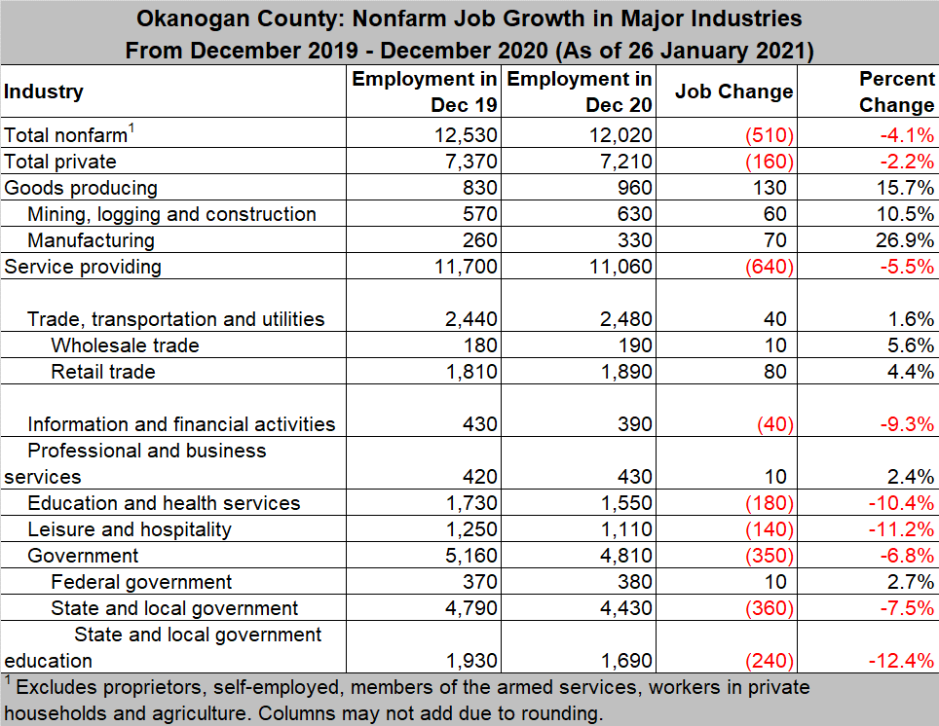
Okanogan County: Nonfarm job growth Between the Decembers of 2019 and 2020 (As of 26 January 2021)
Notes:
The Okanogan County nonfarm market averaged only 12,020 jobs in December 2020 versus 12,530 in December 2019, a 510-job and 4.1-percent downturn.

Slide 19
Long-term labor market trends in the Okanogan County economy
Average annual Okanogan County unemployment rate in 2020 (9.4 percent) was still less than the rate in 2010 (10.7 percent) - during the “peak” of the recent Great Recession.
However, the average annual nonfarm job loss-rate of minus-5.6 percent countywide in 2020 was worse than the minus-3.9 percent loss-rate in 2009.
Agriculture lost jobs at an annualized loss rate of minus-2.5 percent (down 1,260 jobs) from 2009-2019. Conversely, transportation and warehousing added jobs at an annualized growth rate of 15.5 percent (up 306 jobs).
Notes:
(Self explanatory)

Slide 20
Recent (2019-2020) labor market trends in the Okanogan County economy
Unemployment rate rose from 6.8 percent in 2019 to 9.4 percent in 2020. COVID related layoffs drove rates up from April through November 2020.
The Okanogan County nonfarm market lost 710 jobs in 2020 (down 5.6 percent). Washington state lost 160,900 jobs in 2020 (down 4.6 percent).
Sectors losing jobs in 2020: over eighty percent of jobs lost were in leisure and hospitality (down 250 jobs) or state and local government (down 330).
Sectors gaining jobs in 2020: federal government (up 40 jobs) and manufacturing (up 20 jobs).
Notes:
(Self explanatory)

Slide 21
Labor Market Information (LMI): From the Employment Security Department
Labor Market and Economic Analysis website: https://esd.wa.gov/labormarketinfo
Hyperlink to “Labor Market Information – website navigation info” posted on You Tube: https://www.youtube.com/watch?v=5PV3Kkmop8Y
Annual economic reports (County Profiles), such as the Okanogan County Profile 2020 posted at:
https://esd.wa.gov/labormarketinfo/county-profiles/okanogan
Notes:
Our agency, the Labor Market and Economic Analysis (LMEA) branch of the Washington State Employment Security Department (ESD), has a Labor Market Information (LMI) website at: https://esd.wa.gov/labormarketinfo.
An excellent 4 minute and 58 second tutorial/instructional video on this newly designed landing page is provided here: https://www.youtube.com/watch?v=5PV3Kkmop8Y.
Annual, county-level economic reports (called County Profiles) are posted on our agency’s LMI website. Calendar year 2020 reports for Okanogan County are posted at:
https://esd.wa.gov/labormarketinfo/county-profiles/okanogan.
Monthly economic reports (Labor Area Summaries) are prepared every month or two for the seven counties I serve and transmitted direct to clients via email distribution lists. These four- to five-page reports are disseminated via email distribution lists – at no cost. If you would like to be added to a distribution list, please email me (see POC info at Slide 22).

Slide 22
Point of contact (POC) information and questions
Donald W. Meseck
Regional Labor Economist for Adams, Chelan, Douglas, Grant, Kittitas, Okanogan, and Yakima Counties
Labor Market and Economic Analysis (LMEA)
Employment Security Department
Address: Kittitas County WorkSource, 510 N. Pine Street, Ellensburg, WA 98926 Phone: (509) 607-3267 Email: dmeseck@esd.wa.gov
Website: https://esd.wa.gov/labormarketinfo
Notes:
Would like to express my appreciation to Elana Mainer (Co-lead, Okanogan Coalition for Health Improvement, Okanogan County Public Health) for asking me to conduct this presentation.
Are there any questions?

