Slide 1
Okanogan County
Local Health Indicators
March, 2015
Okanogan Tourism: http://www.okanogancountry.com//

Slide 2
Public Health Surveillance
The ongoing systematic collection, analysis, and interpretation of outcome-specific data for use in planning, interpretation, and evaluation of public health practice.
Notes:
Public health surveillance is the ongoing systematic collection, analysis, and interpretation of outcome-specific data for use in planning, interpretation, and evaluation of public health practice.
International, national, state, county, neighborhood.

Slide 3
Data Sources
Notes:
Health related statistics and data sources are increasingly available on the Internet. They can be found already neatly packaged, or as raw data sets. The most reliable data comes from governmental sources or health-care professional organizations.

Slide 4
County Health Rankings
County Health Rankings measures the health of nearly all counties in the US and ranks them within states.
Rankings are compiled using county-level measures from a variety of national and state data sources.
Notes:
The County Health Rankings, a collaboration between the Robert Wood Johnson Foundation and the University of Wisconsin Population Health Institute, measure the health of nearly all counties in the nation and rank them within states. The Rankings are compiled using county-level measures from a variety of national and state data sources. These measures are standardized and combined using scientifically-informed weights.

Slide 5
Ranking System
Overall Health Outcomes
Length of life
Quality of life
Overall Health Factors
Health behaviors
Clinical care
Social and economic factors
Physical environment
Notes:
Counties in each of the 50 states are ranked according to summaries of a variety of health measures. Those having high ranks, e.g. 1 or 2, are considered to be the “healthiest.” Counties are ranked relative to the health of other counties in the same state. We calculate and rank eight summary composite scores:

Slide 6
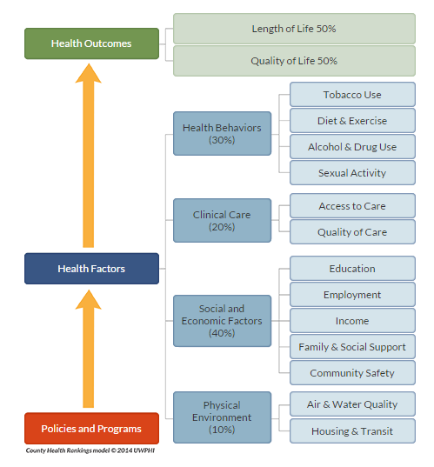
http://www.countyhealthrankings.org/our-approach
Notes:
The Rankings are based on a model of population health that emphasizes the many factors that, if improved, can help make communities healthier places to live, learn, work and play.

Slide 7
Okanogan County: Overall Health Rankings
37th
http://www.countyhealthrankings.org/app/washington/2015/overview
Notes:
The overall rankings in health outcomes represent how healthy counties are within the state. The healthiest county in the state is ranked #1. The ranks are based on two types of measures: how long people live and how healthy people feel while alive.
There are 39 counties in WA State.
http://www.rwjf.org/ = Robert Wood Johnson Foundation

Slide 8
Okanogan County: Health Factor Rankings
35th
http://www.countyhealthrankings.org/app/washington/2015/overview
Notes:
The overall rankings in health factors represent what influences the health of a county. They are an estimate of the future health of counties as compared to other counties within a state. The ranks are based on four types of measures: health behaviors, clinical care, social and economic, and physical environment factors.

Slide 9
County Comparison to WA State
http://www.countyhealthrankings.org/app/washington/2015/compare/snapshot?counties=047
Notes:
This is a snapshot. There are many other indicators that are measured and reported.
Clinical Care: Uninsured,
Primary care physicians
Dentists
1,327:1
Mental health providers
409:1
Preventable hospital stays
39
Diabetic monitoring
86%
Mammography screening
61.7%
Social & Economic Factors
High school graduation
79%
Some college
67.8%
Unemployment
7.0%
Children in poverty
19%
Income inequality
4.4
Children in single-parent households
29%
Social associations
9.3
Violent crime
301
Injury deaths
59
Physical Environment Air pollution - particulate matter 11.0 Drinking water violations 0% Severe housing problems 18% Driving alone to work
73% Long commute - driving alone
DemographicsPopulation41,1936,971,406% below 18 years of age23.4%22.9%% 65 and older19.4%13.6%% Non-Hispanic African American0.5%3.6%% American Indian and Alaskan Native12.2%1.9%% Asian1.0%7.9%% Native Hawaiian/Other Pacific Islander0.2%0.7%% Hispanic18.8%11.9%% Non-Hispanic white66.8%71.0%% not proficient in English5.4%3.9%% Females49.5%50.0%% Rural80.0%16.0%
Health Outcomes Diabetes10%9%HIV prevalence75191Premature age-adjusted mortality363.5287.2Infant mortality5.95.0Child mortality82.842.7
Health Behaviors Food insecurity16%15%Limited access to healthy foods6%5%Motor vehicle crash deaths209Drug poisoning deaths1815
Health Care Uninsured adults31%19%Uninsured children11%6%Health care costs$7,243$7,959Could not see doctor due to cost18%13%Other primary care providers915:11,462:1
Social & Economic Factors Median household income$39,014$58,431Children eligible for free lunch54%37%Homicides53

Slide 10
WA State Incidence – Adult Diabetes
http://www.cdc.gov/diabetes/atlas/countydata/atlas.html
Notes:
From CDC. Tracking over time.

Slide 11
Value of Reliable Data
Provides snapshot of current health status
Identifies trends over time
Provides direction for improvement actions
Assists in prioritizing needs
Provides baseline metrics to track progress and improvements
Minimizes waste (time, resources, effort)
Notes:
Per the businessdictionary.com website, the definition of metrics: Standards of measurement by which efficiency, performance, progress, or quality of a plan, process, or product can be assessed.

Slide 12
Questions?
Every County: http://everycounty.org/2015/01/20/washington-okanogan-county/

