Slide 1
A perspective on data integration and the emerging ACH context ACH Development Council Webinar

Slide 2
Outline
1
Why we need to share data across sectors, agencies, and communities
2
Importance of shared data and integrated data in the ACH context
3
Public Health Systems & Services grant– a timely evaluation opportunity
4
Preliminary landscape of data sharing in King County
5
Core concepts of integrated data
6
Potential next steps

Slide 3
In the United States, our investments do not match our health needs

Slide 4
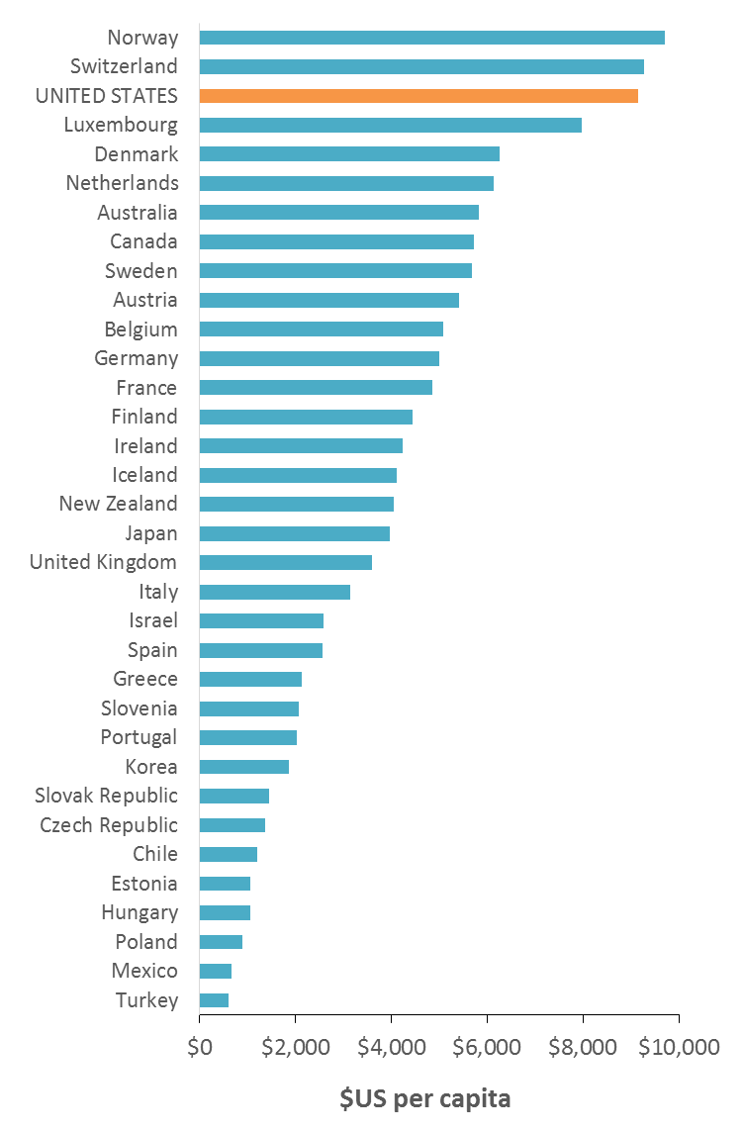
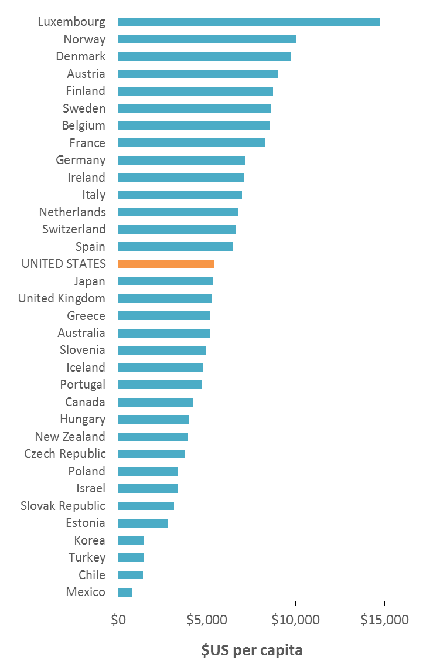
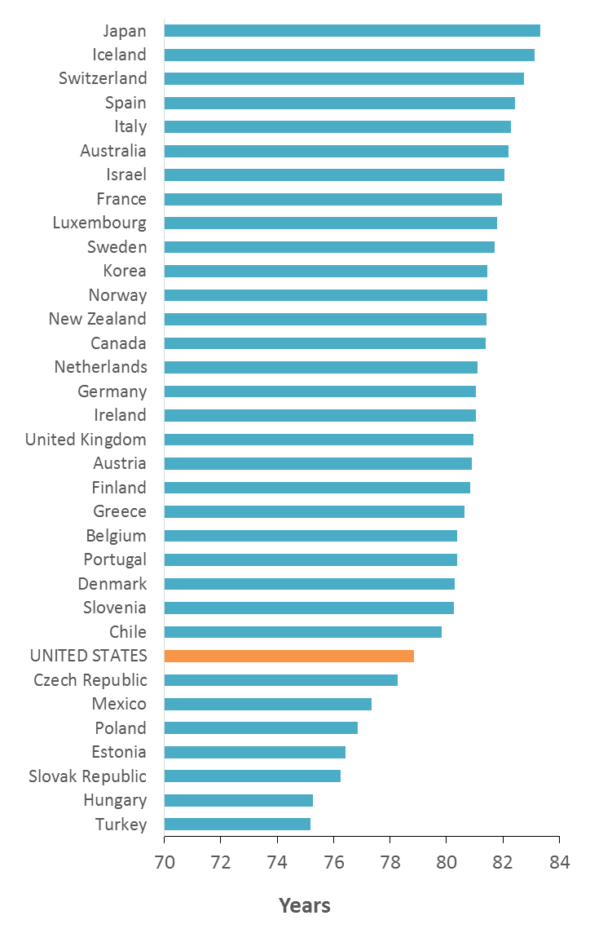
The United States compared to its economic peers
Top spender on
health care
Moderate spender on
social services
Low performer on
life expectancy
Sources: Health expenditures per capita, 2013 and life expectancy at birth, 2013 (World Bank); Social expenditures per capita, 2011 (OECD)
Notes:
Total health expenditure is the sum of public and private health expenditures as a ratio of total population. It covers the provision of health services (preventive and curative), family planning activities, nutrition activities, and emergency aid designated for health but does not include provision of water and sanitation. Data are in current U.S. dollars.
The sum of all social expenditures on active labor market programs, family support, housing support, disability, elderly pensions and services, survivor benefits, unemployment, and other social areas. This excludes public spending on health care, public health, education, and the criminal justice system.

Slide 5
We only spend 5% of our health dollars to address what causes 60% of our avoidable deaths
Causes of avoidable death in the United States¹
United States health expenditures in 2013²
Behavioral health prevention
Chemical dependency prevention
Maternal and child health programs
Public health activities
Research
School health programs
Population-wide approaches
to health improvement
Social factors
Health care
Genetics
Behavior
Environment
Health care
¹ McGinnis et al., The case for more active policy attention to health promotion. Health Affairs 2002; 21(2):78-93.
² Centers for Medicare & Medicaid Services, Office of the Actuary. National health expenditures, by source of funds and type of expenditure. 2013.
Notes:
Causes of avoidable death:
Genetics: heredity (aka what we’re born with), though genetic risks are also influenced by environment and behavior
Social factors: education, employment, income, poverty, housing, crime, and social cohesion
Environment: toxic agents at workplaces, environmental pollutants, chemical contaminants in food and water, and structural hazards (roadway design, lighting, worksite conditions, home hazards, etc.)
Behavior: choices we make with respect to diet, physical activity, and sex, substance abuse and addictions, our approach to safety, and how we cope with stress
Health care: medical treatment of disease and injury
US health expenditures:
Population-wide approaches to health improvement include public health activities, maternal and child health programs, school health programs, research, and treatment and prevention of behavioral health and chemical dependency concerns
Health care includes everything else (i.e. medical treatment of disease and injury)

Slide 6
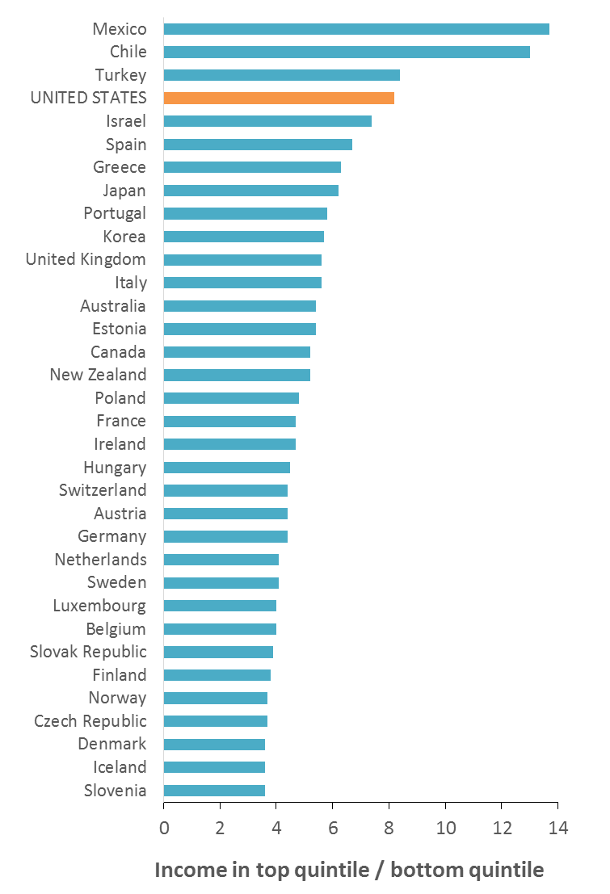
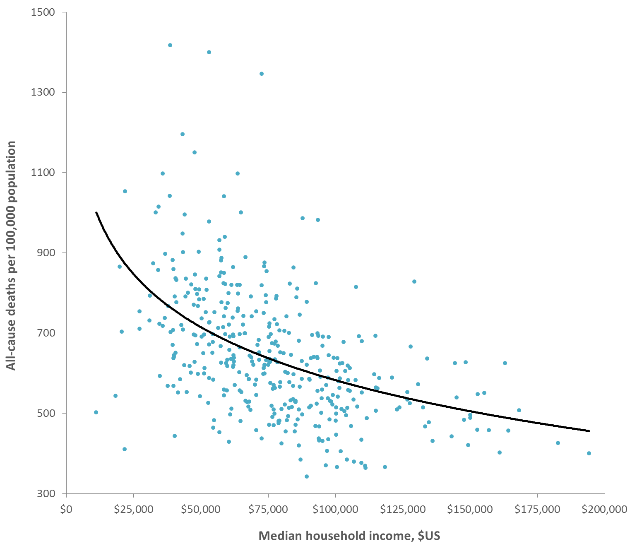
Health follows wealth, and the US suffers from extreme income inequality
Income inequality
Income and all-cause mortality by census tract in King County, 2009-2013
Sources: Income inequality, 2011 (OECD); mortality, 2009-2013 (WA Department of Health, death records); household income, 2009-2013 (American Community Survey)
Notes:
Income inequality is shown here as the S80/S20 ratio, which is the share of all income received by the top income quintile (i.e. top 20% of earners) divided by the share of the lowest income quintile (i.e. bottom 20% of earners). Thus, it is a measure of the relative disparity in income between the highest and lowest-income groups in a community.
All-cause mortality rate is age-adjusted to the US 2000 population.

Slide 7
In King County, there is a broad understanding that health begins where we live, learn, work and play. This is embodied in the Accountable Community of Health.

Slide 8
King County Accountable Community of Health (ACH)
AWARENESS
Due to the complex nature of the upstream drivers of poor health and disparities (i.e. where we live, learn, work and play), we must work across sectors, agencies and communities in order to improve heath and promote equity
VISION
Building healthier communities through a collaborative regional approach focusing on social determinants of health, clinical-community linkages, and whole person care
GOAL
Better health and better quality of care at a lower cost = the Triple Aim

Slide 9
Complex problems require a complex strategy
Problems
Access barriers
System capacity
High costs
Social drivers
Poor health
Siloed services
ACH
Outcomes
Lower cost
Better quality
Equity
Better health
Accelerate
cross sector strategies
Strategies
Cross sector collaboration
Housing
Business
Public health and human services
Criminal justice
Education
Government
Health care
Community groups
Notes:
States, including our state, recognize that to achieve the Triple Aim of improved health, quality of care, and reduced costs, we must increase focus on prevention and seek solutions both within and outside of the clinical system.
One of the core principles embodied in the ACH model is that due to the complex nature of the upstream social drivers of poor health and disparities cross sector, cross-agency, cross-community infrastructure and strategies are essential in order to achieve the Triple Aim.
The goals in this slide are the Triple Aim + equity, and we see represented by the yellow circles the need for cross sector and cross agency work to bring about meaningful progress towards these goals.

Slide 10
QUESTION: Any promising strategies of how you used data to address upstream drivers of poor health and disparities in your communities?

Slide 11
There is great promise in this growing collaborative approach to better understand and serve the whole person. But, how will we know if we are making progress towards the Triple Aim?

Slide 12
Complex strategies require a complex evaluation
Evaluation Loop
Accelerate
cross sector evaluation
Housing-health partnership
Lower cost
ACH
Strategies
Accelerate
cross sector strategies
Outcomes
Physical/ behavioral health integration
Familiar Faces
Better health
Better quality
Communities of Opportunity
Equity
Notes:
Not surprisingly, the same is true for evaluation– cross sector, cross-agency, and cross-community sharing of data and evaluation roles is required for rigorous needs assessment, prioritization of strategies, and evaluation of impact.
No one institution can sustainably improve health or rigorously evaluate impact while working in a silo.
To evaluate the impact of cross sector health promotion initiatives, we need to work across sectors and agencies to leverage our collective assets and evaluation roles. As a county, we need this for several reasons, some of which include:
To make the most efficient use of our data to evaluate whether our reforms live up to their promises.
To send a powerful message to stakeholders, including community-based organizations and the public, that health and non-health organizations are joining together to take a unified approach to evaluation.
To ensure that key evaluation considerations, such as use of an equity lens, are addressed in all evaluation frameworks.
To harness the power of the big data revolution in an era of dwindling funding for population surveys and other public health services.

Slide 13
Public Health Systems & Services Research grant – A timely opportunity
OPPORTUNITY
PHSKC received a 2-year PHSSR grant from the Robert Wood Johnson Foundation, which began on February 1, 2015
PURPOSE
Understand how ACHs influence local health and human services departments’ (LHHSDs) ability to develop shared data and care coordination strategies to support the Triple Aim (King County ACH – North Sound ACH partnership)
QUESTIONS
What factors support or inhibit LHHSD’s ability to develop shared data?
Role of LHHSDs in building shared data through ACH context?
Is novel care coordination (King- Familiar Faces, Whatcom – Intensive Case Management) associated with better health care and jail outcomes?

Slide 14
Multi-ACH evaluation of building shared data and care coordination strategies
= evaluation topic
Housing
King & North Sound ACHs
ACH
planning, pilot & design grants
Jails
Private sector
Current cross sector strategies
Accelerate
cross sector
strategies
Collective Impact
Health & human services agencies
Education
Common agenda
Shared measurement system
Mutually reinforcing activities
Continuous communication
Backbone function
Health care
Other gov’t agencies
Impact
Intermediate Outcomes
Short-term Outcomes
Triple Aim
Examples:
Improved utilization of clinical preventive services
Decreased avoidable ED visits
Decreased jail involvement
Examples:
Regional, cross-sector:
Shared data system
Care coordination strategies

Slide 15
We need data integration to coordinate care across sectors and measure progress towards the Triple Aim, but what we have in King County is data fragmentation.

Slide 16
Landscape of King County data assets to measure progress towards the Triple Aim
WA State
Non-profit and private sector
OFM
All-Payer Claims Database
HBE
WA Health Plan Finder
OFM
Education Research Data Center
Qualis Health
WA Health Alliance
DSHS
Automated Client Eligibility System (ACES)
HCA
HIE – Link4Health - CDR
“Data Lake” to be developed through SIM
DSHS
RDA Integrated Client Database
Hospital systems
Community Health Centers
DSHS
TARGET
&
PRISM
HCA
ProviderOne claims
DOH
Vital stats, surveys, hospitalization
ED Information Exchange
Health plans
King County
Department of Adult & Juvenile Detention
Department of Community & Human Services –
MHCADS Division
Public Health – Seattle & King County
Other Seattle/King County agencies
Familiar Faces
Juvenile booking data
Chemical dependency treatment
APDE – VS, survey, admin data, BoD
Criminal justice (e.g. police, courts)
High Utilizer Integrated Database
JHS EHR (PEARL)
Department of Assessments
CD – syndromic, notifiable dx, imms.
Medicaid eligibility
CHS – PHCs, Access & Outreach
Division of Aging & Disability Services
Legend
Adult booking data
Emergency Medical Services
Data sharing …
Mental health treatment (RSN)
Public Housing Authorities
Environmental Health
established
PRISM
Safe Harbors
in process
Medical Examiner
Click for glossary of terms
Notes:
All of these data sources are intentionally presented in their own little boxes. This is because data fragmentation or separation is the default environment in King County and WA state.
Data sharing or linkages requires active efforts to build trusting relationships across agencies, investment in infrastructure to support data sharing, linkages, and interoperability, and development of legal contracts to support sharing of data.
This slide shows some established and pending data sharing pathways that are relevant to monitoring the Triple Aim in King County.
Barriers are everywhere and importantly, barriers exist across sectors, across agencies, and across divisions within agencies.
Not all barriers are the same – barriers include commercial, IT infrastructure, legal, political, and resource constraints.

Slide 17
QUESTION: How could the ACHs begin to unpeel all of these different data systems to address our regional health priorities? Where is square one?

Slide 18
Impact of data fragmentation
Data systems are program specific and largely do not talk with each other = data fragmentation
Health and human services providers struggle to:
Provide whole person care
Avoid care gaps and overlaps
Quickly and easily report significant events to other providers
Analysts struggle to:
Provide policymakers and program managers with actionable and timely information
Accurately and rigorously measure progress

Slide 19
QUESTION: What is the role of the ACH around informing the development of shared data systems? What is the promise for ACHs of such systems?

Slide 20
One solution to data fragmentation is to build an Integrated Data System

Slide 21
Shared, integrated, interoperable, open data – what’s the difference?
Shared
data¹
Sharing of individual or aggregate data between 2 or more entities
Often supported by a data sharing agreement, a formal contract documenting how data will be shared, used, and protected
Integrated
data²
“Integrated Data Systems link individual level data from different agencies to improve programs and practices through evidence-based collaboration”
Interoperability³
Ability to interoperate - or mix - different datasets
Open
data³
Data that can be freely used, re-used and redistributed by anyone - subject only, at most, to the requirement to attribute and share
¹ iHRIS, “Creating a data sharing agreement”. http://www.ihris.org/toolkit-new/pilot/presentation-creating-a-data-sharing-agreement/
² Actionable Intelligence for Social Policy. University of Pennsylvania, 2015. http://www.aisp.upenn.edu/
³ Open Data Handbook, “What is open data?” http://opendatahandbook.org/guide/en/what-is-open-data/

Slide 22
Integrated Data Systems (IDS) used for care coordination and population-level analysis
IDS uses for
health & human services providers
IDS uses for
analysts
Learn
Gain deeper understanding of events and risk factors that shape a client’s outcomes
Plan
Gain deeper understanding of clients and service patterns to identify new policy initiatives
Coordinate
Coordinate care with other providers to minimize care gaps and overlaps (whole person care)
Do
Develop and refine programs and practices, and guide allocation of resources
Alert
Notify other providers of significant events
Check
Evaluate the impact and cost-effectiveness of policies and programs
Adapted from Prashant, Kumar (2011). An overview of architectures and techniques for integrated data systems implementation. Actionable Intelligence for Social Policy, University of Pennsylvania.

Slide 23
Three types of IDS
Types of IDS
Local examples
Need based
Manual or automated linkage of cross agency data to address a specific program need
Familiar Faces
Integrated Client Database (DSHS)
Periodic
Periodic and routine linkage of cross agency data to address a class of program needs
Linked Birth-Hospitalization files (DOH)
Continuous
Continuous, automated linkage of cross agency data to allow real-time care coordination and analysis
High Utilizer Integrated Database (DCHS)
Increasing
complexity
and utility
Adapted from Prashant, Kumar (2011). An overview of architectures and techniques for integrated data systems implementation. Actionable Intelligence for Social Policy, University of Pennsylvania.

Slide 24
Architecture of an IDS prototype
Federated
data access
Data filter / Confidentiality rules
Care Coordination
Learn
Maximize
client
health and wellbeing
Police data
Coordinate
EMS data
Alert
Shared client
index
Jail data
Physical health care data
Shared provider index
Shared learning
Homeless data
Low-income housing data
Analytics
Plan
Maximize population
health and wellbeing
Cross agency
data warehouse
Chemical dependency data
Do
Behavioral health care data
Check
Insurance claims data
Adapted from Prashant, Kumar (2011). An overview of architectures and techniques for integrated data systems implementation. Actionable Intelligence for Social Policy, University of Pennsylvania.
Notes:
A data warehouse collects data from multiple administrative systems, links them together, and stores them in a centralized repository:
The data warehouse integrates client data across agencies into shared entities such as Client, Family, Care Episode, and Service Plan.
The data warehouse retains historical data and maintains consistent cross-agency reference data about service provider organizations, types and names of services, and types of outcomes.
It is an attractive option to support policy analysis and research.
Federated data architecture allows data in the distinct administrative systems (i.e. not integrated) to be dynamically extracted, linked, and presented to the user:
No need to store all the data in a shared database. Instead, when a user submits a request for information, the federated data system breaks the request into a set of queries and pulls data from the relevant administrative systems
It is an attractive option to support real-time client case management

Slide 25
IDS governance
Data use policies
Technology
Service levels
Compliance risk
Data quality
IDS governance
Health & human services providers
Analysts
Adapted from Prashant, Kumar (2011). An overview of architectures and techniques for integrated data systems implementation. Actionable Intelligence for Social Policy, University of Pennsylvania.
Notes:
Data use: which data can be used, how it will be used, data interpretation guidelines, and training requirements for data use
Compliance risk: identify stakeholders and processes for ensuring adherence to privacy and confidentiality requirements. Includes processes for monitoring, measuring, and controlling disclosure of sensitive client information.
Data quality: identify stakeholders and processes for monitoring, measuring, and controlling the accuracy, timeliness, consistency, and reliability of data.
Technology: identify stakeholders, processes, roles and expectations for coordinating the data and systems architecture planning the IDS. Sets data exchange standards.
Service levels: clarify roles and responsibilities of data provider and data consumer agencies.
All together, the IDS governance structures works to serve the needs of human services providers (case management) and analysts (population-level analysis)

Slide 26
QUESTION: Should the ACHs play a role in governance of shared data? Who (or what) else would if not us?

Slide 27
Towards integrated data in King County

Slide 28
Potential ideas (not yet vetted) for moving forward in King County
1
Build common understanding of data integration requirements, needs & priorities
2
Demonstrate how data integration can promote equity and social justice
3
Leverage existing initiatives to explore/test opportunities for data integration
4
Build on existing infrastructure, and align with the state and other ACHs
5
Identify costs and logistics for different approaches to data integration
6
Use a phased, continuous improvement approach to break down data siloes one by one

Slide 29
APPENDIX
FOR MORE INFORMATION, CONTACT:
Eli Kern MPH RN | Epidemiologist Assessment, Policy Development & Evaluation Public Health - Seattle and King County Phone: 206.263.8727 | Email: eli.kern@kingcounty.gov

Slide 30
Glossary of Terms
ACH – Accountable Community of Health
AIMS - Advancing Integrated Mental Health Solutions, University of Washington
APDE – Assessment, Policy Development & Evaluation, PHSKC
BoD – Burden of Disease
CD – Communicable disease
CDR – Clinical Data Repository, Link4Health
CHS – Community Health Services, PHSKC
DAJD – King County Department of Adult and Juvenile Detention
DCHS – King County Department of Community and Human Services
DSHS – WA State Department of Social and Health Services
ED – Emergency department
EHR – Electronic health record
ERDC – WA State Education Research & Data Center
HBE – WA Health Benefit Exchange
HCA – WA State Health Care Authority
HHC – King County Hospitals for a Healthier Community
HIE – Health Information Exchange
HWC – Healthy Washington Coalition
IHME – Institute for Health Metrics and Evaluation
KCIT – King County Information Technology
MHCADSD – King County Mental Health, Chemical Abuse and Dependency Services Division
NSACH – North Sound Accountable Community of Health
OFM – WA State Office of Financial Management
OIC – WA State Office of Insurance Commissioner
PHC – Public Health Center
PHSKC – Public Health – Seattle & King County
PMW – Performance Measurement Workgroup, King County ACH
PRISM – Predictive Risk Intelligence System, DSHS
PSB – King County Office of Performance, Strategy, and Budget
RDA – Research & Data Analysis Division, DSHS
RSN – Regional Support Network
SIM – State Innovation Model
SWOB – Strengths, weaknesses, opportunities, and barriers
TARGET – Treatment & Assessment Report Generation Tool, DSHS
VS – Vital statistics
WAHA – Whatcom Alliance for Health Advancement
WHA – WA Health Alliance
Click to return to data landscape

Slide 31
Definitions
Accountable Communities of Health: In WA and in several other states around the nation, there is increasing recognition that local, community-level partnerships are powerful factors in the work to improve people’s health and well-being. Regionally-based models to support collaboration, which go by different names in different states, are actively being developed and tested. Here in WA, the proposed structure is called “Accountable Communities of Health” (ACH) and is described in the state’s health innovation plan, Healthier Washington. Washington defines an ACH as “a regionally governed, public-private collaborative or structure tailored by the region to align actions and initiatives of a diverse coalition of participants in order to achieve healthy communities and populations.” The current King County ACH proposed path forward for 2015 has identified 5 existing cross-sector initiatives that could be supported by the ACH over the next year (Communities of Opportunity, Health-Housing Partnership Planning Group, Physical/Behavioral Health Integration, Familiar Faces, Medicare-Medicaid Dual Eligibles Demonstration), all of which have needs related to cross sector data access and analysis.
All-Payer Claims Database: In 2013, the Office of Financial Management was awarded a $3.4 million grant by the Center for Medicare and Medicaid Services to support increased health care price transparency by establishing a statewide all-payer health claims database (APCD). State House Bill 2572 called for the creation of the APCD, though with some significant restrictions. This bill describes what would be more accurately called a “Some-Payer Claims Database” in that only Medicaid and Public Employee Benefits Board program claims are mandatory, and commercial carriers and self-funded employers may contribute claims data on a voluntary basis. Additionally, the bill states that no individual data supplier (e.g. a commercial health plan) comprises more than 25% of the claims data used in any report or analysis generated from the APCD. If the APCD is strengthened to include all claims and access to data by government agencies and research teams is not cost prohibitive, the APCD would likely provide the state, issuers, providers, and consumers the information necessary to compare quality and cost of health care services and support progress towards a more equitable and cost-effective healthcare system.
Clinical Data Repository: See Link4Health.
Communities Count: A public-private partnership that provides data to monitor the health and well-being of King County communities, inform funding decisions, engage citizens, and complement existing civic, economic, and environmental indicators.
Department of Health “Informatics Roadmap”: As informaticians, Bryant Karras and Frank Westrum of the WA State Department of Health will be developing and “Informatics Roadmap” for the state in 2015, in the context of the State Health Care Innovation Plan. The initial vision is to support exchange of data with the healthcare system, integrating data systems within and outside of public health, and making these data assets readily available to public health partners, including Accountable Communities of Health.
Department of Social and Health Services Integrated Client Database: The Research and Data Analysis (RDA) Division within DSHS have built the Integrated Client Database (ICDB) to support answering policy, program, and evaluation questions that require linked cross-sector data on an individual-level. The ICDB rests upon data sharing agreements that pull information from over 30 data systems across and outside of DSHS, including education, criminal justice, employment, claims, vital statistics, housing, child welfare, developmental disabilities, behavioral health, and economic services. The IDCB lives in a potential state, implying that a linked database can be constructed to answer a given evaluation or research question. External requests can be costly, beginning around $45,000+ per project.
Familiar Faces: One of the first HHTSP individual-level strategies, the goal of Familiar Faces is to improve the health, housing stability, justice system involvement, and costs of providing services to individuals who frequently use the King County jail and have behavioral health concerns. This is an ongoing partnership between PHSKC and DCHS facilitated by LEAN consultants. The project team is currently mapping the current states of jail, housing, and health processes for Familiar Faces in order to propose an ideal future state, which will be used in 2015 Q1 to identify potential interventions. In order to both assess current needs of Familiar Faces, and monitor impact of interventions over time, cross agency, cross sector data infrastructure is needed.
Health Information Exchange: The 2009 American Recovery and Reinvestment Act (ARRA) included the Health Information Technology for Economic and Clinical Health (HITECH) Act, designed to support state-level Health Information Exchange (HIE) infrastructure and encourage use of Electronic Health Records by providers through Meaningful Use incentives. In 12/2010, WA was awarded $11.3 million by the Office of the National Coordination for Health Information Technology to begin building an HIE. The Governor designated the Health Care Authority as the lead implementation agency, with the HIE Lead Organization as OneHealthPort, and the Foundation for Health Care Quality to oversee the work of OneHealthPort in pricing, privacy, and access policies. The HIE went live in 6/2011. Healthcare organizations that join the HIE are called “trading partners”, and are currently able to share continuity of care documents, admit discharge notifications, community referrals and consult reports, Health Level 7 (HL7) messages including Admission, Discharge, Transfer and lab/procedure/clinical results, eligibility and benefits, immunizations, and ePrescribing. The annual subscription fee to join the HIE is proportional to annual revenue, and ranges from $600 - $48,000. As of 12/16/2014, the OneHealthPort website reported 133 healthcare organizations were participating across WA state.

Slide 32
More definitions…
Health Reform Evaluation Synergy: In 2013, PHSKC and the University of Washington Department of Health Services partnered to design a framework, based on national and local guidance, as well as key local priorities, to monitor the implementation and impact of the Affordable Care Act (ACA) in King County by proposing key quality assurance and evaluation questions based on existing and potential data sources. With the goal of developing a practical and transparent evaluation framework, the project team engaged with over 25 local, state and national public and private organizations to identify the framework’s scope and metrics. During the course of this stakeholder engagement process, it became clear that there was a need for increased collaboration and synergy among local and state efforts to evaluate the impacts of health reform on health care and health outcomes in WA. This notion planted a seed that grew into a call for a meeting of government agencies, professional organizations, non-profits and evaluators to assess the current landscape of health reform evaluation efforts, clarify common barriers to conducting practical and rigorous evaluation, and identify opportunities for collaboration and synergy across agencies, sectors, and jurisdictional boundaries. Over the past 2 months, a group of 14 organizations have met to discuss these issues, and is currently working to identify priority ACA evaluation questions that are relevant to all stakeholder groups, clarify data access barriers and potential solutions, and propose a governance structure for moving this work forward.
Healthier Washington: Washington state’s plan for how to transform its health care system and achieve the Triple Aim, submitted to the Center for Medicare and Medicaid Services as a proposal for a 4-year State Innovation Models Initiative Round Two Model Test Award. WA state was awarded a $65 million Model Test Award on December 16, 2014. Healthier Washington has proposed a substantial investment in improved analytics, interoperability and measurement of health system performance to support care delivery, clinical-community linkages, and improved health outcomes. Specifically, the plan proposes three major areas of investment. First, enhance the state’s Health Information Exchange to improve interoperability of clinical records between sectors (e.g. physical, behavioral health) and health care organizations. Second, build a dedicated research and analytics partnership between RDA and the Department of Health informatics unit to integrate real-time client and population data sets across multiple sectors (with evaluation of Healthier Washington being led by the University of Washington Department of Health Services). Third, the Institute for Health Metrics and Evaluation will support Healthier Washington by mapping community health to better understand regional health, burden of disease, and potential barriers and behaviors that impact health. There is also some language around the intent to build regional data capacity through the ACH, but no specific approaches are identified in Healthier Washington.
Housing-Health Partnership Planning Group: A partnership of housing authorities, low-income housers, the Health Care Authority, Department of Health, and other organizations, led by Mercy Housing (one of the nation’s largest non-profit low-income housers), to develop a sustainable business model for improving the health of multifamily affordable housing residents by using affordable housing as a platform for housing-health partnerships. This work is coordinated by leadership consultant Betsy Lieberman, founding director of Building Changes. Currently, Betsy is engaging with the King County Housing Authority and Partners for our Children, to explore the possibility of the latter building an integrated database and data portal to facilitate storage, analysis, and dissemination of housing data (Public Housing Authorities, Mercy Housing) and other datasets including Medicaid claims, vital statistics, and hospitalization data.
King County Affordable Care Act Quality Assurance and Evaluation Framework: A framework, developed through a partnership between PHSKC and the University of Washington, to monitor the implementation and impact of the ACA in King County. The Framework links fundamental goals of the ACA, key topic areas and indicators, an equity lens, and secondary and primary data sources. An initial report describing the Framework and baseline health outcomes and disparities in King County was disseminated in October 2014. Moving forward, PHSKC will strive to link this work with the Health Reform Evaluation Synergy effort.
King County Burden of Disease Assessment Tool: One traditional role of local health departments is to act as primary provider of community wide health information, stemming from the core public health function of assessment. Local health departments face major challenges in producing burden of disease information, including a lack of common methods, metrics, and infrastructure to quantify and visualize burden. To meet local information needs and address these challenges, PHSKC, in partnership with the University of Washington’s Institute for Health Metrics and Evaluation (IHME), has received a $200,000 18-month grant from the de Beaumont Foundation to develop a King County Burden of Disease Assessment Tool, which began in January 2015.
King County Community Health Indicators: A set of indicators measuring the health of King County residents. It was developed to provide a broad array of comprehensive, population-based data to community-based organizations, community health centers, public agencies, policymakers and the general public. Community Health Indicators were conceived as a follow-up to the 2002 Institute of Medicine report, The Future of the Public’s Health in the 21st Century, which emphasizes relying on data about the entire community to look at multiple determinants of health. The website will soon be updated to contain indicators used in the King County Hospitals for a Healthier Community’s Community Health Needs Assessment.
King County Health and Human Services Transformation Plan (HHSTP): The HHSTP calls for a local shift from a “costly, crisis-oriented response to health and social problems, to one that focuses on prevention, embraces recovery, and eliminates disparities”. It is in direct alignment with the Triple Aim of concurrently achieving better health, better care, and reduced costs. The HHSTP was accepted by the King County Council in 7/2013, received $1 million to jumpstart implementation in 11/2013, and convened a cross sector Advising Partners group in early 2014. The plan’s has two initial strategies: 1) an individual-focused, whole person strategy designed to improve health and social wellbeing among “Familiar Faces”, or adults with complex health and social needs that frequently utilize health and social services, and 2) a place-based strategy to improve health and social wellbeing in the neighborhoods that experience the greatest burden of ill health and disparities. The place-based strategy is supported by the Seattle Foundation through the Communities of Opportunity initiative (funded in 3/2014), and a Living Cities planning grant (funded in 5/2014).

Slide 33
And some more…
King County Hospitals for a Healthier Community (HHC): King County HHC is a collaborative of all 12 non-profit hospitals and health systems in King County and PHSKC. HHC members have joined forces to identify the most important health needs and assets in the communities they serve. The collaborative report will soon be available online. In addition to the indicators presented in the report, supplemental indicators will all be available on the King County Community Health Indicators website.
Link4Health: A multi-year initiative of the Health Care Authority to enable real time medical, dental, social service support and behavioral health care information to follow the patient across care settings and over time. A partnership with the WA’s Health Information Exchange (OneHealthPort), Link4Health’s first statewide service will be the Clinical Data Repository (CDR), which will provide authorized access to an integrated clinical record for Apple Health enrollees. The CDR will be launched in mid-to-late 2015 and staged over 3-plus years.
OneHealthPort: A private organization designated by the Health Care Authority as the Lead Organization in WA state for implementing the Health Information Exchange (see Health Information Exchange). In addition to the HIE, OneHealthPort also provides the provider credentialing service ProviderSource (vendor Medversant), as appointed by the Office of the Insurance Commissioner through State Senate Bill 5346 in 2009. Providers must regularly complete the credentialing process in order to obtain hospital/facility privileges and enroll in health plans as a participating provider. Providers enrolled in ProviderSource must attest to the accuracy of their data at least once every 150 days. The intent is that ProviderSource is the standard credentialing service for all health plans and hospitals in WA state.
Performance Measures Coordinating Committee: In 2014, the Washington State Legislature passed ESHB 2572, a law relating to improving the effectiveness of health care purchasing and transforming the health care delivery system. A portion of this legislation (Section 6) relates to the development of a statewide core measure set for health care quality and cost. In response, Governor Inslee appointed a 34-member Performance Measurement Coordinating Committee (PMCC) that was charged with recommending standard statewide measures of health performance by January 1, 2015. It is intended that use of these measures will enable a common way of tracking health and health care performance as well as inform public and private health care purchasers. Use of the measures is expected to start with the State as “first mover;” Healthier Washington calls for eventual alignment of measurement across public and private payers, using the core measure set as the basic set to which other measures may be added. The PMCC presented a final “starter set” of 54 population, clinical and health care cost measures on December 17, 2014.
Physical/Behavioral Health Integration: A statewide initiative driven by Healthier Washington with the goal of designing and implementing a fully integrated care and financing model for physical and behavioral health services.
Prevention Framework: As a key deliverable of the State Health Care Innovation Plan, DOH and HCA formed a public-private, multi-sector partnership to develop a comprehensive Prevention Framework as a blueprint for state and community partners to drive population health improvement. Among other things, the Prevention Framework proposes how the State, regional and local communities could measure their success, in alignment with the statewide core measure set. As Healthier Washington is implemented, DOH and HCA will work together to lead and govern the state’s continued work on a Plan for Improving Population Health, to be completed in January 2016.
Robert Wood Johnson Foundation (RWJF) Public Health Services and Systems Research grant: Washington state’s developing ACH, regional health collaborations of public health, clinical care delivery and human services with greater focus on prevention, intend to improve health and quality of care and ultimately reduce costs. PHSKC has received a grant from RWJF to support a study to assess the association of ACH activities, including shared data systems and care coordination strategies, with improved health and criminal justice outcomes for adults with complex medical and social needs. The project will assess ACH development processes in King and Whatcom Counties to assess factors that facilitate or inhibit the local human and health services departments’ (LHHSD) ability to build regional shared data measurement and care coordination systems. This 2-year project began in February 2015.
State Health Care Innovation Plan: The final deliverable of the $1 million State Innovation Models Initiative Round One Model Pre-Testing Award, which was used to develop Healthier Washington.

